Slide 1

IBM CLOUD (SMART BRIDGE)

Slide 2
PROJECT NAME: INTELLIGENT CARGO MANAGEMENT SYSTEM USING INTERNET OF THINGS:
TEAM MEMBERS NAMES:
TEAM:11
V.SOWMYA
V.SRAVANI
R.BHUPAL

Slide 3
ABSTRACT:
My research is on the transportation and logistics chains. Products are transported between
different places in different stages within a supply chain. The transportation has a large
impact on both responsiveness and efficiency. Faster transportation allows a supply chain
to be more responsive but reduces its efficiency within a supply chain (Chopra & Meindle,
2007, p.53). Transportation has a significant impact, because it controls the speed of
response and reply as stated in Newton’s third law of every action there is always opposed
an equal reaction. An example of Amazon is a company that sells products on the internet
and uses UPS or FedEx, which is a transportation company that delivers products to
customers. This is an example of transportation within a supply chain. In logistic today

Slide 4
BLOCK DIAGRAM:
DHT11
SENSOR
.
RASPBERRY PI
ALARM
IBM CLOUD
MQ135
MIT INVENTOR
MESSAGE

Slide 5
HARD WARE COMPONENTS:
INPUT PROCESSOR OUTPUT
DHT11 SENSOR -RASPBERRYPi - MIT INVENTOR
TRUCK -MQ135 CHIP -MASSAGE

Slide 6
WORKING PRINCIPLE:
An initiation of our project we will check and tear weight of a weighing
panel using load cell & HX711 module. Identify exact weight of cargo or
package which is placed above weighing panel using load cell &hx711
module. The identified weight of cargo is stored in database which is
present remotely through internet. Speed of cargo movement is detected
using gps module. As and when the cargo is in movement with a minimum
speed limit, the weight of cargo will be recursively checked with exact
value stored in database through programming logic. As the speed exceeds

Slide 7
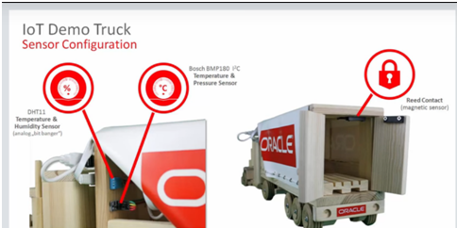
.

Slide 8
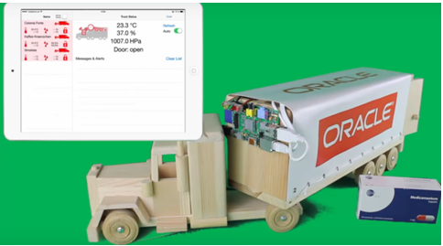
.

Slide 9
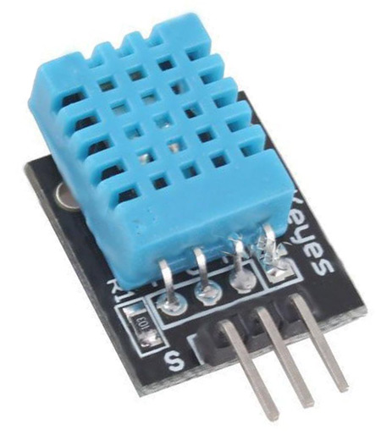
DHT11 MODULE:
DHT11 Specifications:
Operating Voltage: 3.5V to 5.5V
Operating current: 0.3mA (measuring) 60uA (standby)
Output: Serial data
Temperature Range: 0°C to 50°C
Humidity Range: 20% to 90%
Resolution: Temperature and Humidity both are 16-bit
Accuracy: ±1°C and ±1%
Note: The DHT11 datasheet can be found at the bottom of the page

Slide 10
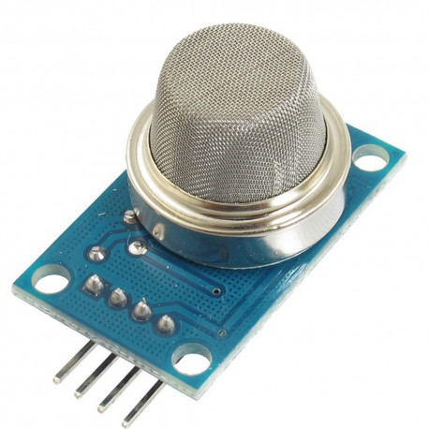
MQ135 MODULE:
Specification:
Product Name: Gas Sensor Module
Model: MQ-135
Type: Analog
Detecting Type: Air Quality
Sensitivity to Ammonia, Sulphide and Benzene steam
Rated Voltage: DC 5V
Detecting Range: 100-1000ppm
Pin Quantity: 4
Pin Definition : AO - Analog Output, DO - Digital Output, GND - Ground, VCC - Voltage To Current Converter

Slide 11
ADVANTAGES:
Manipulation of cargo can be easily tracked.
Cargo will be in surveillance during the transition between
source and destination.
DISADVANTAGES:
Internet connectivity is mandatory.

Slide 12
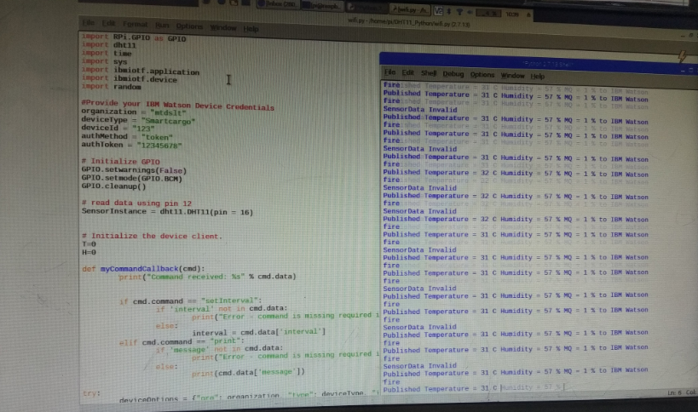
RESULT:

Slide 13
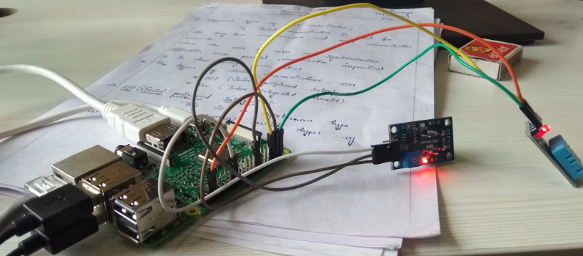
PRACTICAL RESULT :

Slide 14
CONCLUSON:
In this project we have implemented an intelligent cargo
system for efficient transportation of goods from a given
source to destination. The sensors are simulated using the
route map. The most preferential route is taken in order to
effectively maintain the state of the product in the
desirable state. Simulation is used to generate the
trajectories of a route. As future work real time situations
like traffic, truck breakdown and catastrophic effects can
be considered in order to improve the results.

Slide 15


